Slide 1
Object Oriented
UML Class Diagram
CSC207 – Software Design

Slide 2

7 - Design a software system, in terms of interfaces, which contain headers of public methods, for the following problem statement: (20)
  Customers order products from an online store; their orders will be processes by the closest store to their address, and their bills will be issued. After the payment is done, items will be shipped to the customer address.

Slide 3

Standardized general-purpose modeling language
  Used to specify, visualize, construct, and document the design of an object-oriented system under development
  Offers a way to visualize various elements of a system such as activities, actors, business processes, database schemas, logical components, programming language statements, and reusable software components.
  Combines techniques from data modeling(entity relationship diagrams), business modeling (work flows), object modeling, and component modeling
Booch, Rumbaugh & Jacobson are principal authors
  Still evolving (currently version 2.3)
  Attempt to standardize the proliferation of OO variants
Is purely a notation
  No modelling method associated with it!
  Was intended as a design notation
  Can be used anywhere in the software development cycle
Has become an industry standard
  But is primarily promoted by IBM/Rational (who sell lots of UML tools, services)
Has a standardized meta-model
  Use case diagrams , Class diagrams, Message sequence charts, Activity diagrams, State Diagrams , Module Diagrams, …

Slide 4

UML Class Diagrams information structure relationships between data items modular structure for the system | Use Cases user’s view Lists functions visual overview of the main requirements
UML Package Diagrams Overall architecture Dependencies between components | (UML) Statecharts responses to events dynamic behavior event ordering, reachability, deadlock, etc
UML Sequence Diagrams individual scenario interactions between users and system Sequence of messages | Activity diagrams business processes; concurrency and synchronization; dependencies between tasks;

Slide 5

A class describes a group of objects with
  similar properties (attributes),
  common behaviour (operations),
  common relationships to other objects,
  and common meaning (“semantics”).
Examples
  Employee: has a name, employee# and department; an employee is hired, and fired; an employee works in one or more projects
Employee
Name (mandatory)
Attributes
(optional)
name
employee#
department
hire()
fire()
assignproject()
Operations
(optional)

Slide 6

Attribute
type
Name of the class
Attribute
name
Student
+ name: string [1] = “Anon” {readOnly}
+ registeredIn: Course [*]
+ register (c: Course)
+ isRegistered (c: Course) : Boolean
Other Properties
Visibility:
+, -, #
Default value
Multiplicity
Operation
name
Return value
Parameters

Slide 7

The instances of a class are called objects.
  Objects are represented as:
  The relation between an Object and its Class is called “Instantiation”
  Two different objects may have identical attribute values (like two people with identical name and address)
  Note: Make sure attributes are associated with the right class
    E.g. you don’t want both managerName and manager# as attributes of Project! (…Why??)
Fred_Bloggs:Employee
name: Fred Bloggs
Employee #: 234609234
Department: Marketing

Slide 8

Objects do not exist in isolation from one another
  A relationship represents a connection among things.
  E.g. Fred_Bloggs:employee is associated with the KillerApp:project object
  But we will capture these relationships at the class level (why?)
Class diagrams show classes and their relationships
  In UML, there are different types of relationships:
    Association
    Aggregation and Composition
    Generalization
    Dependency
    Realization

Slide 9

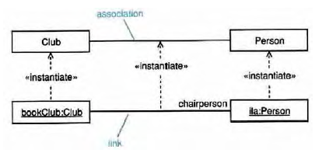
Associations are semantic connections between classes.
  If there is a link between two objects, there must be an association between the classes of those objects.
  Links are instances of associations just as objects are instances of classes.
Association
Link

Slide 10
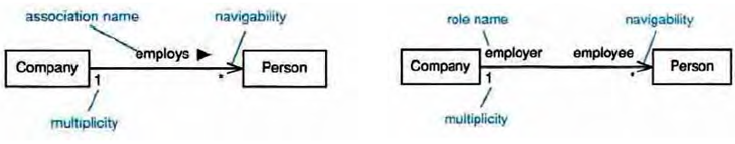
Associations may optionally have the following:
  Association name
    may be prefixed or postfixed with a small black arrowhead to indicate the direction in which the name should be read;
    should be a verb or verb phrase;
  Role names
    on one or both association ends;
    should be a noun or noun phrase describing the semantics of the role;
  Multiplicity
    The number of objects that can participate in an instantiated relation
  Navigability
Association name
navigability
role name
navigability
*
*
multiplicity
multiplicity

Slide 11

Ask questions about the associations:
  Can a company exist without any employee?
    If yes, then the association is optional at the Employee end - zero or more (0..*)
    If no, then it is not optional - one or more (1..*)
    If it must have only one employee - exactly one (1)
  What about the other end of the association?
    Can an employee work for more than one company?
    No. So the correct multiplicity is one.
Some examples of specifying multiplicity:
  Optional (0 or 1) 0..1
  Exactly one 1 = 1..1
  Zero or more 0..* = *
  One or more 1..*
  A range of values 2..6
Company
1
0 .. *
Employee

Slide 12

Multiplicity
A client has
exactly one staffmember
as a contact person
Multiplicity
A staff member has
zero or more clients on
His/her clientList
Name
of the
association
:Client
:StaffMember
companyAddress
companyEmail
companyFax
companyName
companyTelephone
staffName
staff#
staffStartDate
1
liaises with
0..*
contact
person
ClientList
Direction
The “liaises with”
association should be
read in this direction
Role
The staffmember’s
role in this association
is as a contact person
Role
The clients’ role
in this association
is as a clientList

Slide 13

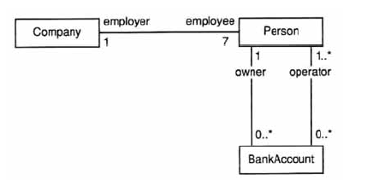
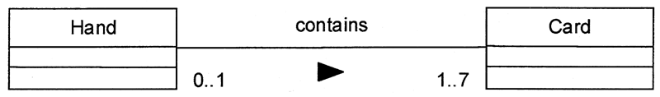

Slide 14

Order
+ dateReceived: Date [0..1]
+ isPrepaid: Boolean [1]
+ lineItems: OrderLine [*] {ordered}
Date
0..1
*
Order
1
Boolean
+dateReceived
+isPrepaid
1
*
+lineItems {ordered}
OrderLine

Slide 15

Person
0..1
*
Car
How implement it?
Person
+ carsOwned: Car [*]
Car
+ Owner: Person [0..1]
Implementation Complexities !

Slide 16

Generalization is a relationship between a more general thing and a more specific thing:
  the more specific thing is consistent in every way with the more general thing.
  the substitutability principle states that you can substitute the more specific thing anywhere the more general thing is expected.

Slide 17

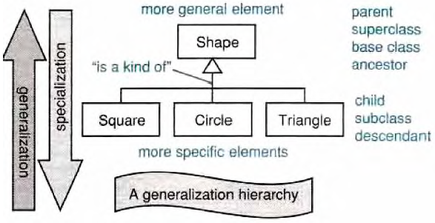
Generalization hierarchies may be created by generalizing from specific things or by specializing from general things.
More general element
Parent
Superclass
Ancestor
Base Class
“is a kind of”
Child
Subclass
Descendant
Leaf
More specific element

Slide 18

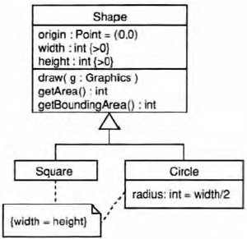
Class inheritance is implicit in a generalization relationship between classes.
Subclasses inherit attributes, associations, & operations from the superclass
What is the inheritance mechanism in Java?

Slide 19
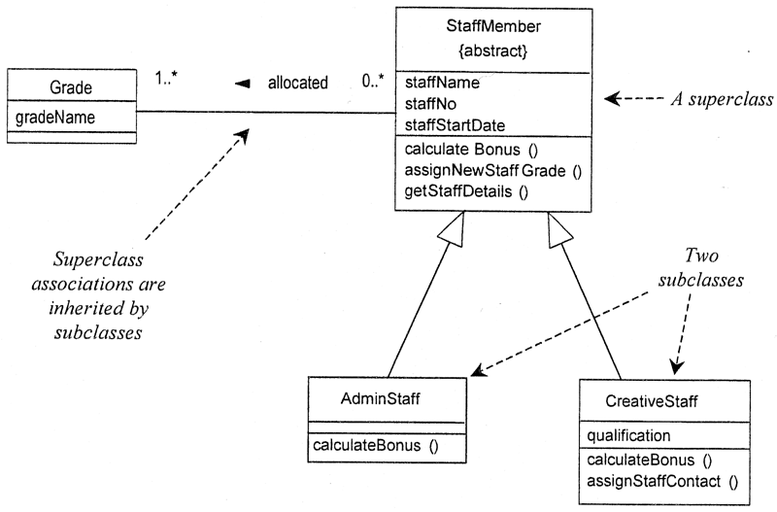

Notes:
  A subclass may override an inherited aspect
    e.g. AdminStaff & CreativeStaff have different methods for calculating bonuses
  A Subclass may add new features
    qualification is a new attribute in CreativeStaff
  Superclasses may be declared {abstract}, meaning they have no instances
    Implies that the subclasses cover all possibilities
    e.g. there are no other staff than AdminStaff and CreativeStaff

Slide 20

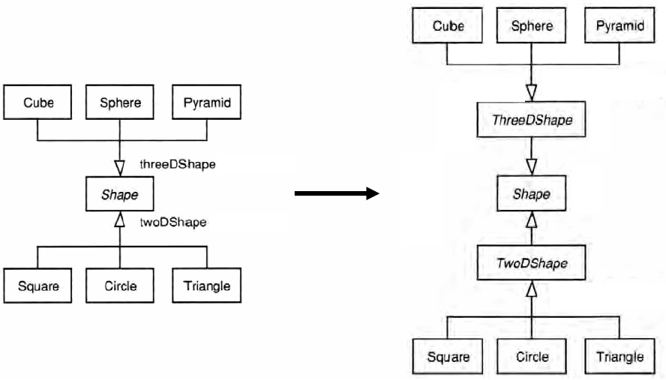

Slide 21

Aggregation
  This is the “Has-a” or “Whole/part” relationship
aggregation
Club
Member
*
*
:Car
:Train
0..1
:Person
0..1
0..*
driver
1
passengers
aggregation

Slide 22
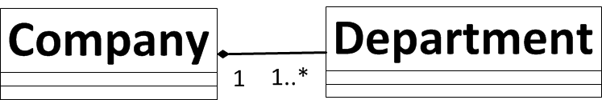
Aggregation
  This is the “Has-a” or “Whole/part” relationship
Composition
  Strong form of aggregation that implies ownership:
    if the whole is removed from the model, so is the part.
    the whole is responsible for the disposition of its parts
    Note: Parts can be removed from the composite (where allowed) before the composite is deleted
Polygon
{ordered}
Point
centre
Circle
3..*
1
Note: No sharing - any instance of point can be part of a polygon or a circle, but not both (Why?)

Slide 23
1
:Engine
composition
:Locomotive
1..*
1
0..1
:Car
:Train
0..1
:Person
0..1
0..*
driver
1
passengers
aggregation

Slide 24

Draw the UML class diagram which represents a file system – containing files and directories

Slide 25
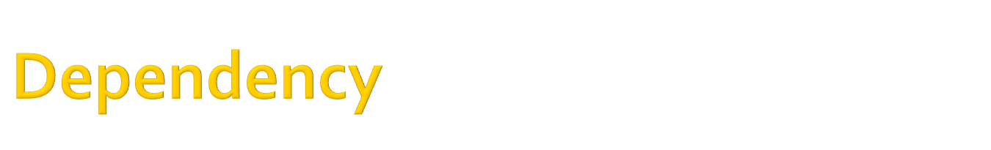
Dependencies are relationships in which a change to the supplier affects, or supplies information to, the client.
The client depends on the supplier in some way.
Dependencies are drawn as a dashed arrow from client to supplier.
Model
View
ViewController
Layout

Slide 26

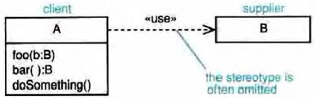
«use»-the client makes use of the supplier in some way -this is the catch-all.
«call»-the client operation invokes the supplier operation.
«parameter»-the supplier is a parameter or return value from one of the client's operations.
«instantiate»-the client is an instance of the supplier.
client
Supplier
The stereotype is often omitted

Slide 27
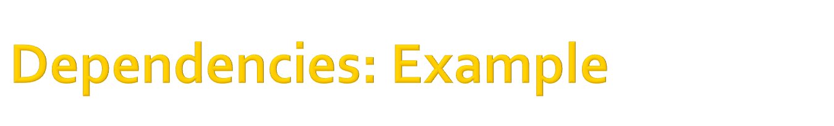
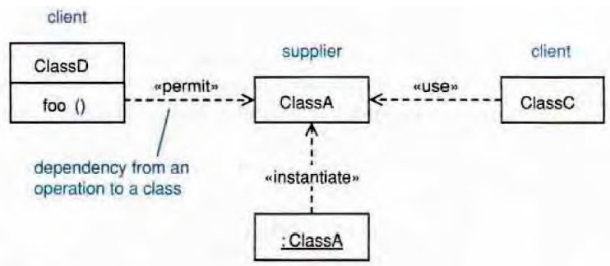
client
Supplier
client
<<call>>
<<use>>
Dependency from an operation to a class
<<instantiate>>
Example Dependency types:
<<call>>
<<use>>
<<create>>
<<derive>>
<<instantiate>>
  <<permit>>
  <<realize>>
  <<refine>>
  <<substitute>>
  <<parameter>>

Slide 28

<<interface>>
Collection
equals
add
Order
LineItems [*]
<<interface>>
List
get
<<realizes>>
ArrayList
get
add
<<requires>>
Collection
Order
LineItems [*]
List
ArrayList
Notes:
There are classes that have nothing but pure virtual (abstract) functions. In Java such entities are not classes
at all; they are a special language element called an interface. UML has followed the Java
example and has created some special syntactic elements for such entities.

Slide 29

Comments
  -- can be used to add comments within a class description
Notes
Constraint Rules
  Any further constraints {in curly braces}
  e.g. {time limit: length must not be more than three months}
Date Range
Start: Date
End: Date
/length: integer
{length = start - end}

Slide 30

Division of Responsibility
  Operations that objects are responsible for providing
Subclassing
  Inheritance, generalization
Navigability / Visibility
  When objects need to know about other objects to call their operations
Aggregation / Composition
  When objects are part of other objects
Dependencies
  When changing the design of a class will affect other classes
Interfaces
  Used to reduce coupling between objects

Slide 31

What makes a good analysis class?
  Its name reflects its intent.
  It is a crisp abstraction that models one specific element of the problem domain.
  It maps to a clearly identifiable feature of the problem domain.
  It has a small, well-defined set of responsibilities:
    a responsibility is a contract or obligation that a class has to its clients;
    a responsibility is a semantically cohesive set of operations;
    there should only be about three to five responsibilities per class.
  It has high cohesion – all features of the class should help to realize its intent.
  It has low coupling – a class should only collaborate with a small number of other classes to realize its intent.

Slide 32
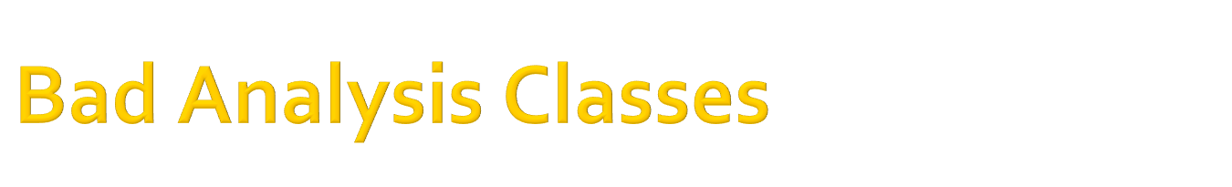
What makes a bad analysis class?
  A functoid- a class with only one operation.
  An omnipotent class -a class that does everything (classes with "system" or "controller" in their name may need closer scrutiny).
  A class with a deep inheritance tree -in the real world inheritance trees tend to be shallow.
  A class with low cohesion.
  A class with high coupling.
  Many very small classes in a model – merging should be considered.
  Few but large classes in a model – decomposition should be considered.

Slide 33

Noun/Verb Analysis (Grammatical Parsing)
CRC Analysis
Use-Case-Based Analysis
Real-World Analysis

Slide 34
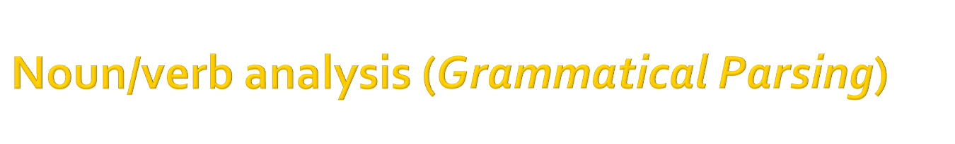
1.Collect as much relevant information about the problem domain as possible; suitable sources of information are:
  The requirements model
  The use case model
  The project glossary
  Any other document (architecture, vision documents, etc.)
2.Analyze the documentation:
  Look for nouns or noun phrases -these are candidate classes or attributes.
  Look for verbs or verb phrases -these are candidate responsibilities or operations.
    Always think about running methods on objects.
      e.g. given Number objects “x” and “y”
    x.add(y) is more OO than x = add(x, y)
3.Make a tentative allocation of the attributes and responsibilities to the classes.

Slide 35
Some OO Jargons !

Slide 36
Static Methods.
But not all methods in Java are called on objects,... what’s going on here?
Some times methods are required that don’t run against a specific object.
  Initial program method (“main”)
  Factory methods
  Methods that are not object specific
Any methods or fields that are not related to a specific object are declared as “Static”. They are class methods or fields

Slide 37
Static
A static field is one that is the same for all objects. E.g. static pi.
A static method is one that is the same for all objects.
Static methods can’t refer to none static fields. Why?
Static methods don’t need to be called on a particular objects. (Classname.method())

Slide 38
Nested Class
A nested class is one that is declared inside another class.
  a member of the enclosing class
  private, public, protected, or default
  may be static

Slide 39
Static Nested Class
Does not need an instance of outer class
Essentially just an outer class that is
declared inside another outer class can be private
sometimes called top-level nested class
OuterClass.StaticNestedC n = new OuterClass.StaticNestedC();

Slide 40
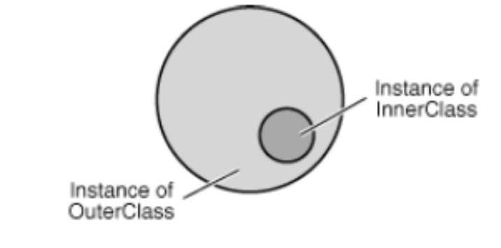
Inner Classes
non static nested class
declared within an instance of the outer class
has access to private members of outer class
OuterClass.InnerClass innerObject = outerObject.new InnerClass();

Slide 41
Why Bother?
Logical Grouping of Classes
Encapsulation
More readable and maintainable code

Slide 42
Example
public class DataStructure {
//create an array
private final static int SIZE = 15;
private int[] arrayOfInts = new int[SIZE];
public DataStructure() {
//fill the array with ascending integer values
for (int i = 0; i < SIZE; i++) {
arrayOfInts[i] = i;
}
}

Slide 43
Add an EvenIterator
public void printEven() {
//print out values of even indices of the array
InnerEvenIterator iterator = this.new InnerEvenIterator();
while (iterator.hasNext()) {
System.out.println(iterator.next() + " ");
}
}

Slide 44
private class InnerEvenIterator {
private int next = 0;
public boolean hasNext() {
  //check if a current element is the last in the array
  return (next <= SIZE - 1);
}
public int next() {
  //record a value of an even index of the array
  int retValue = arrayOfInts[next];
  //get the next even element
  next += 2;
  return retValue;
}
}

Slide 45
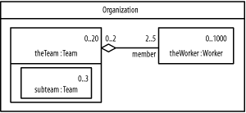
How to model Inner classes in UML?
Aggregation
DataStructure
<<OuterClass>>
InnerEvenIterator
<<InnerClass>>

Slide 46
Local Classes
member class that is declared within a body of a method or instance initializer
scoping rules make this useful

Slide 47
Anonymous Classes
A local class that has no name
One statement declares and creates an object for the class
  new parentClassName (params) { body}
  new interfaceName() { body}

